Slide 1
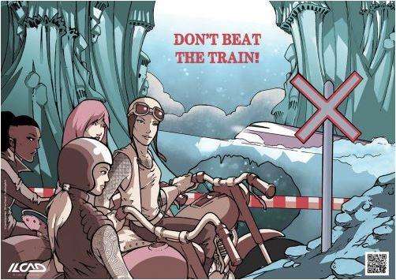
“GUIDE OF SAFE LIVING WITH THE RAILWAY NETWORK FOR
STUDENTS”
Accident prevention and information programme

Slide 2
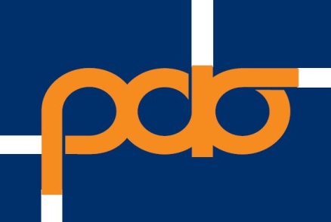

PROGRAMME ORGANISERS
Regulatory Authority for Railways (RAS)
Railway Transport Safety Authority, responsible for safety issues in the Greek network.
Hellenic Railways Organisation (OSE)
Infrastructure Manager of the Greek Railway Network, responsible for installation, infrastructure maintenance and traffic management.

Slide 3
Reason - Purpose - Objective
Reason
recurrent fatal accidents in the railway network
Objective
providing information & raising students’ awareness as regards risks entailed in the railway network
Purpose
Prevention & reduction of accidents in the railway network

Slide 4
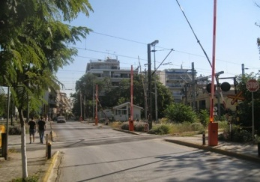
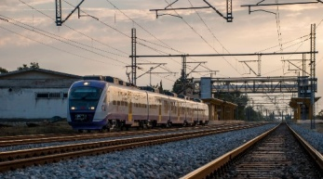
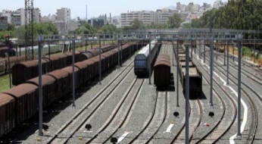
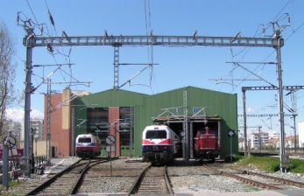
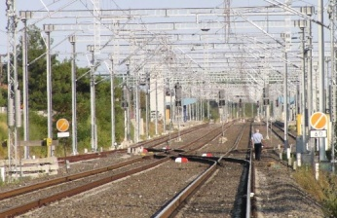
Points where most accidents occur
1. Level crossings
2. Electrification
3. Immobilised or stationary rolling stock.
4. Railway stations / facilities
5. Along the railway line

Slide 5
1a. Level crossings
Automated Protection System (LCAS)
emits a loud audio signal
electric lights flash
Safety barriers come down
VIDEO 1
https://youtu.be/LFtIQk8gVmU
train passing
Barriers go up, traffic resumes

Slide 6
1b. Level crossings guarded by a trained guard
uses a whistle to warn pedestrians & vehicles
VIDEO 2
https://youtu.be/ESQa6zFqtM0
lowers safety barriers
checks that the train has passed and that no other one is coming
lifts up the barriers, traffic resumes

Slide 7
1c. Non – guarded pedestrian level crossings
They have no safety means -
are the most dangerous
once you reach in front of them, stop completely
VIDEO 3
https://youtu.be/zVGi5d0XPtc
check carefully in both directions
cross the line quickly only after you make sure there is no danger

Slide 8

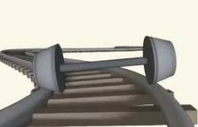

Level crossings - Why are trains different
the train cannot stop in time
huge mass
reduced friction coefficient due to metallic wheels
VIDEO 4
https://youtu.be/qlIqsjpC0LQ
Stopping distance > over 800 metres!

Slide 9






Level crossings - Instructions for drivers
Respect the signs
Watch out for traffic jams
Slow down
Mind vehicle length
Lower the volume of music
Do not stop on tracks

Slide 10






Level crossings - Instructions for drivers
Do not manoeuvre
If the signals go off while you are on the line, continue crossing
Wait for all warning signals to stop and for the barriers to open completely
If your vehicle is trapped between the barriers, move on, even if it means breaking them
Don’t forget: Trains may be coming from both directions
If the vehicle stalls on the lines, help passengers out and run away

Slide 11
Level crossings - Instructions for drivers
VIDEO 5
https://youtu.be/VPr8-1uFl_Q

Slide 12
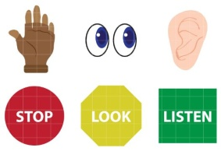
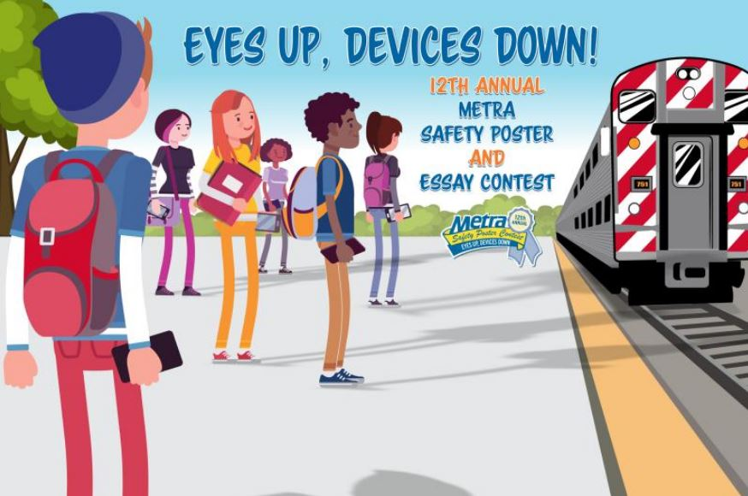
Level crossings - Instructions for pedestrians
Stop - Look - Listen
ATTENTION:
Most accidents involve people who cross specific crossings very often.
Doing the same thing every day
means that you may not be as careful as you should!
Always remain vigilant!
Look in both directions
Do not use mobile phones or headphones

Slide 13
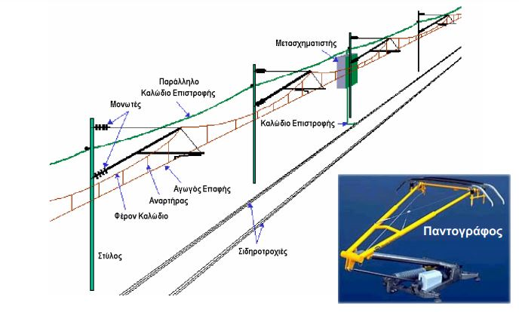
2. Electrification
Transformer
Metallic posts
Return cable
overhead contact line
Pantograph
25,000v
240v
Mains electricity
Pantograph
Railway tracks
100 times more
VIDEO 6
https://youtu.be/_rpgOp7s-DE

Slide 14
Measures to protect against electrification hazards
Contact line
Railway line
Stay off -
play safe
Do not climb on trees
If you see any cut live wires, stand clear (over 10 metres) and notify the police.
Do not fly a kite
Do not throw
water - metal objects
Do not touch rails, light signal masts

Slide 15
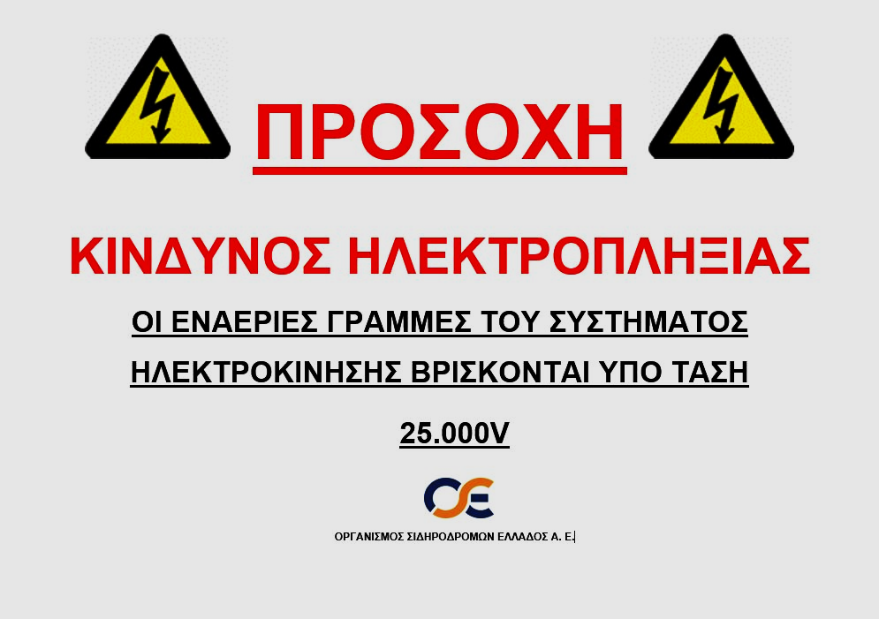
OSE has posted information signs at Railway Stations
ATTENTION
SHOCK HAZARD
THE ELECTRIFICATION SYSTEM’S OVERHEAD CONTACT LINES ARE LIVE (25.000 V)

Slide 16
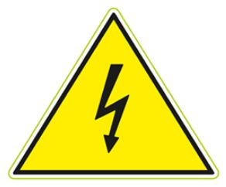
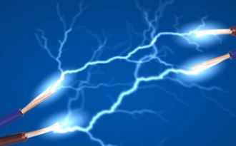
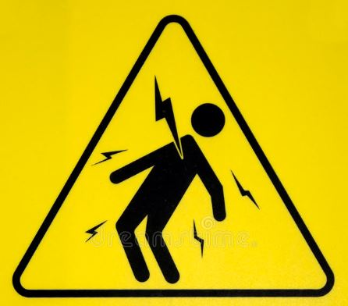
2. Electrification
The first contact
is also
the last
Electricity gives no warning
Electricity is not visible
VIDEO 7
https://youtu.be/SnaJCDtXmZo
IT KILLS

Slide 17

3. Immobilised or stationary rolling stock
children wanting to play / paint graffiti / take pictures climbed on rolling stock
Result:
they were electrocuted by the overhead electrification lines.
9 such fatal accidents in the last 8 years

Slide 18
3. Immobilised or stationary rolling stock
Entering railway facilities, whether fenced or not, is prohibited
Climbing on wagons is prohibited, as you will be near the overhead electrification lines
ATTENTION:
You can get an electric shock even without touching a wire. Being near it is enough. An electric arc is created, which can cover a distance of 2m

Slide 19
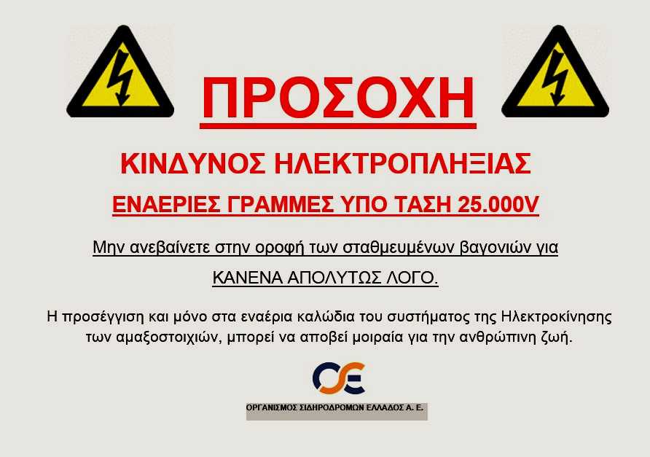
OSE has posted information signs advising against climbing on wagons
ATTENTION
SHOCK HAZARD
LIVE OVERHEAD CONTACT LINES (25.000 V)
Do not climb on top of stationary wagons
FOR ANY REASON AT ALL
Even only approaching the overhead wires of the train electrification system might be fatal for human life.

Slide 20
4. Railway stations - facilities
Do not cross the track, or pass through wagons stopped on Railway Station platforms
Use only the platforms, underpasses, overpasses or public lifts
In railway facilities, use only the public corridors
Do not approach areas with the warning signs “CAUTION - Risk of electric shock”
What to do

Slide 21
5. Along the railway line
People walking or standing next to the track in a non-fenced network
Trespassing into the fenced network through gaps or by jumping over the fence
Result:
Pedestrian hit by the train

Slide 22
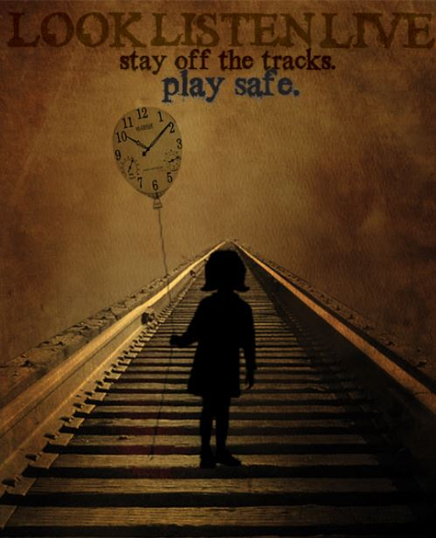
5. Along the railway line - Instructions
Do not trespass through the fencing of the railway network
If you need to move close to / along the lines, keep a safety distance (at least 5 metres)
Always remain vigilant. As soon as possible, move away from the railway line.

Slide 23
Crash test
Train - car crash
VIDEO 8
https://youtu.be/9HVdcJdDtlI

Slide 24
Move with care at level crossings
VIDEO 9
https://youtu.be/XZXCogIEFeU

Slide 25
Take your time
Don't risk your life
VIDEO 10
https://youtu.be/QqvDclPebGU

Slide 26
Take your time
Don't risk your life
VIDEO 11
https://youtu.be/fZOq8_OVfqM

Slide 27



International Level Crossing Awareness Day
Organised
in the 1st week of June
Cooperating bodies
The initiative has been coordinated by the UIC International Union of Railways since 2009 with the support of the Worldwide Railway Organisation (CER, EIM) and other Organisations (ETSC, Operation Lifesaver, LDz ).
A joint commitment to raise public awareness about the dangers at level crossings.
The “Panos Mylonas” Institute for Road Safety and TRAINOSE have been participating in ILCAD since 2009.

Slide 28
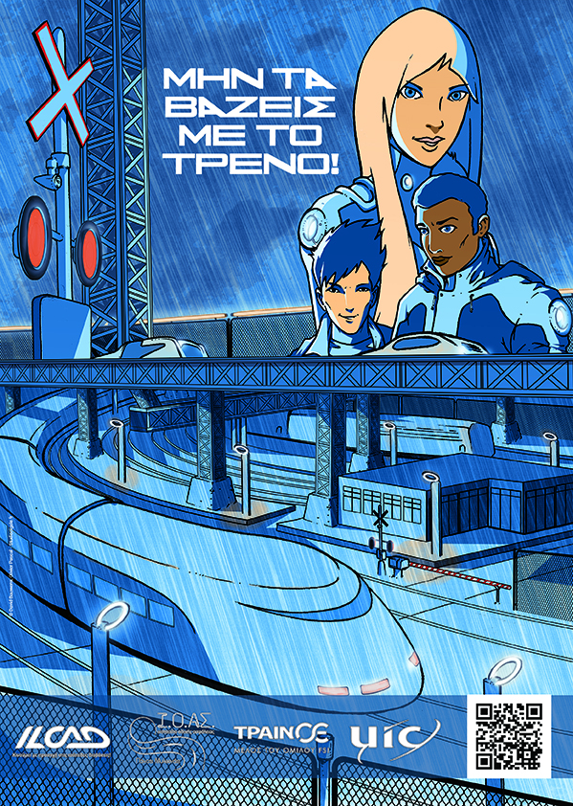
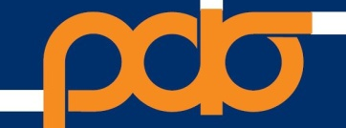
Programme creators
Kapetanidis Kostas
Civil engineer
Kondylas Nikos
Electrical engineer
Avdis Stephanos
Civil engineer
The presentation used data from
OSE – TRAINOSE – ILCAD – NETWORK RAIL

